Slide 1

Data Science project for Opal usage
in Transportation of NSW
Group Members:-
Ajit Kumar Chaudhary (46124942)
Avinash Pandey (46139001)
Bipin Sahu (46136150)
Saraj Nakarmi (45750793)

Slide 2
Problem Statement
The Opal card travel system is governed by the transport authority of the New South Wales Government. It is an immensely prevalent travelling arrangement which is a contactless ticket collection system made accessible for the ease of public transportation services in the greater Sydney region of New South Wales, Australia. In this project, we will depict following things:-
Number of tap-on and tap-off based on location on both daily and monthly basis using visualization libraries.
The relationship between the different travelling age groups and their respective location using pandas.
Naive Bayes Classifiers to predict busiest and emptiest route.

Slide 3
Data Source
The data set comes from open data transport for NSW. These new open datasets are large and provide an opportunity to gain a much better understanding of how cities and regions function. The data set used are:-
Total no of monthly bus trips including location, Variants and count of total number of passengers. Link:- Opal trips Bus.
Total no of tap on/tap off in a particular location in a day. It includes mode of transportation, date, tap type, time, location and count of total number of passengers. Link:- Opal tap-on/off location

Slide 4
Method Used:-
Libraries:- Bokeh (Interactive visualization library) , Pandas , geoviews (creating maps)
Missing values: There are some missing values which need to be eliminated. For example: For some data sets the postal code field has negative value (-1) which represents the null value. These data need to be eliminated.
Data Mapping: Some data are not meaningful, and we need to map those data with a new data set to make it meaningful. For example: Postal code is provided in the data set for the opal card, but the name of the suburb is not given. So, we need to get another dataset which contains information about postal code and suburb and map to our original data set.
Data Grouping: Grouping of the records to get details based on age group and city. For example: Grouping the data based on age and getting the total value of the respective age group for graphical representation and analysis.
Predictive algorithm: Naïve Bayes Classifiers

Slide 5
Number of tap-on and tap-off based on location on both daily and monthly basis using visualization techniques.
We have used Bokeh and geoviews libraries to show visualization and maps. Bokeh is an interactive visualization library that targets modern web browsers for presentation. By using these libraries we will try to visualize and answer following questions:-
Q1. What are the most and least popular stations in Sydney ?
Q2. Which route is busiest or emptiest based on Bus service?
Q3. Which is the peak hour where we see the most traffic congestion on the station?

Slide 6

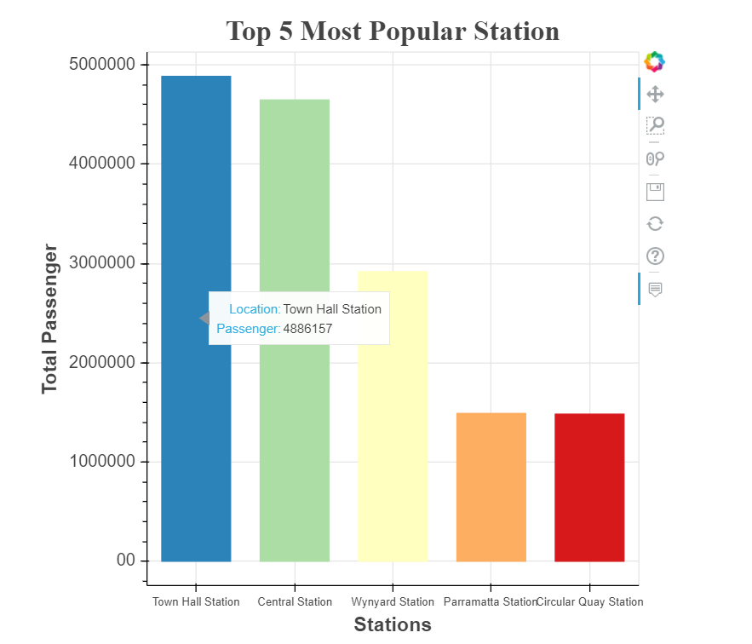
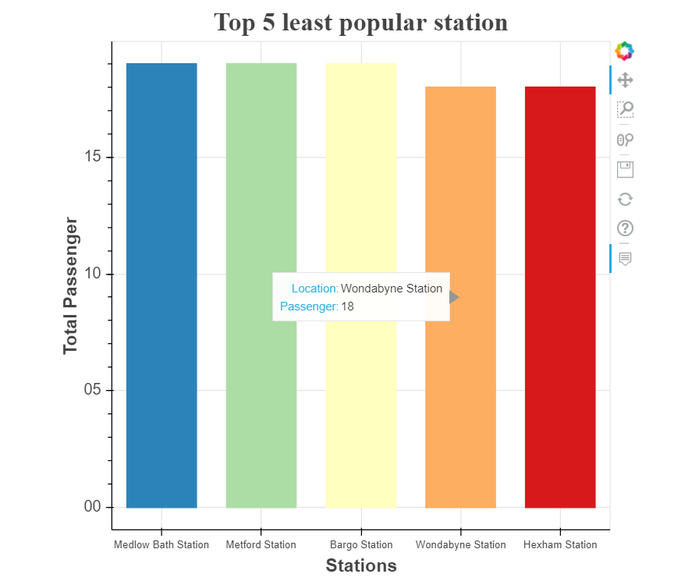
Q1. What are the most and least popular stations in Sydney ?

Slide 7
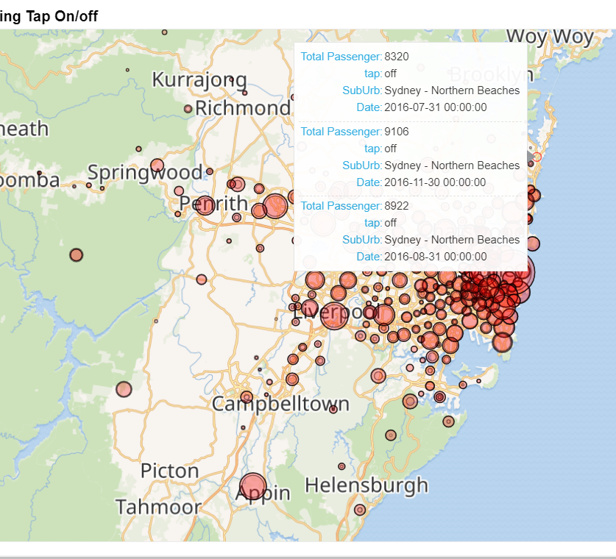
Q2. Which route is busiest or emptiest based on Bus service?
We have added mapped using geoview libraries. The map shows the number of tap on/ off in different location of Sydney.
It gives total passenger count, tap details, suburb location and the date of tap on/off

Slide 8
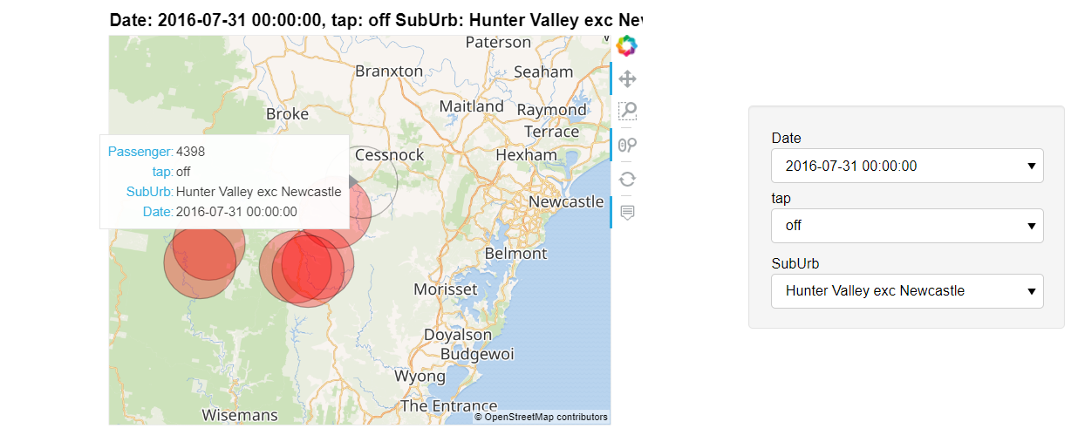
More interactivity using widgets..
We have added filter based on date, tap and sub urb. This enhances the flexibity to perform more detail analysis on the map.

Slide 9
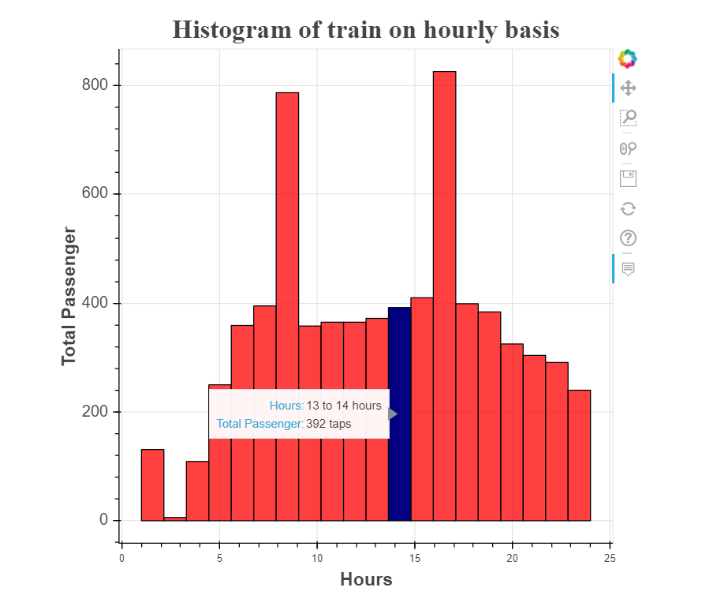
Q3. Which is the peak hour where we see the most traffic congestion on the station?
In this diagram, we see hourly service of a train. We can see that the peak hour seems to be from 8 to 9 and 3 to 4.

Slide 10
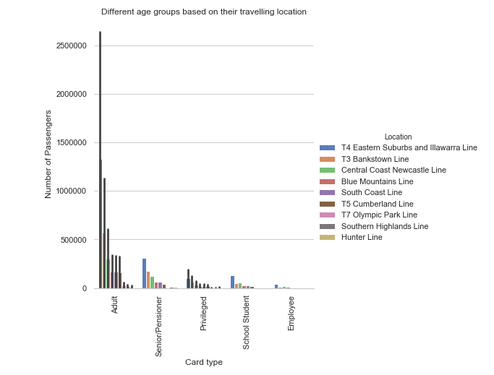
GRAPH ILLUSTRATING RELATIONSHIP BETWEEN THE DIFFERENT TRAVELLING AGE GROUPS AND THEIR RESPECTIVE LOCATION ON A PARTICULAR DATE

Slide 11
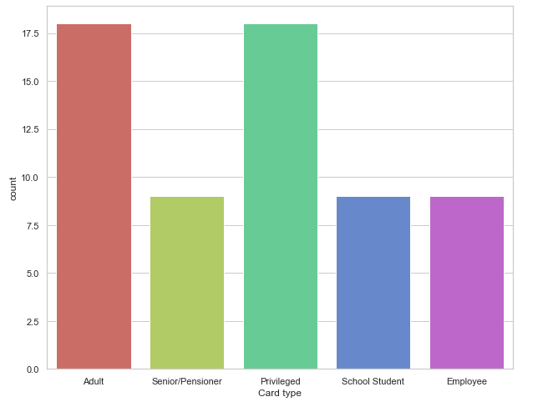
GRAPHICAL COMPARISON OF TRAVELERS IN OVERALL AS PER THE AGE GROUP DETERMINED BY THE TRAIN CARD

Slide 12
Naive Bayes Classifiers to predict busiest and emptiest route
Using Multinomial NB classifier
Assumptions: we have defined status field to know the volume of total passengers.
Low (Population ranges between 0 to 100000)
Moderate (Population ranges between 100000 to 400000)
High (populate ranges between 400000 to 10000000)

Slide 13
Naive Bayes Classifiers to predict busiest and emptiest route
Converting categorical variables to a dummy indicators using LabelEncoder.
Testing and training of data to build a predictive model
Accuracy score on test and train data is 0.9978

Slide 14
Interpretation of Algorithm
There are 3 status ('Low', 'Moderate', 'High') of routes. As we see (0.9978)99.78% accuracy in data, we can perform further test in this training model in real world setting to determine the status of a location. Since we do not see a huge gap in accuracy score between training data and test data, there are no overfitting and the model looks good based on the provided data set. Now, lets pick 328 in the train data, which is the highest number not seen in the diagonal to explain for misclassification. Based on this number, we can say that the actual value for third status('High') is 328 but our model predicted it to be the first status('Low').

Slide 15
Conclusion
We were able to predict the busiest route based on determining the status of a location by using Naïve Bayes algorithm. However, such assumption are not completely reliable to predict the model.
The conclusion to our research are we cannot reliably predict the busiest and emptiest route.
We believe that with more robust data we could improve our models to a level in which we could make much more accurate predictions.
One way we could improve our data would be by obtaining algorithms and techniques to determine the status of a location.

Slide 16
Demo..

